Slide 1
Real-Time Cryptocurrency Analysis System
LiangZhihao WangXue
2020 Jun -> July
Group 14

Slide 2
Outline
Background & Motivation
Objective
System Architecture
System Deployment Specification
Experiment Results

Slide 3
Outline
Background & Motivation
Objective
System Architecture
System Deployment Specification
Experiment Results

Slide 4
Background & Motivation
Sharp cryptocurrency market volatility
Social media opinion is a good indicator of market price
Real-time data explosion
Real-Time analyzation tool helps decision making

Slide 5
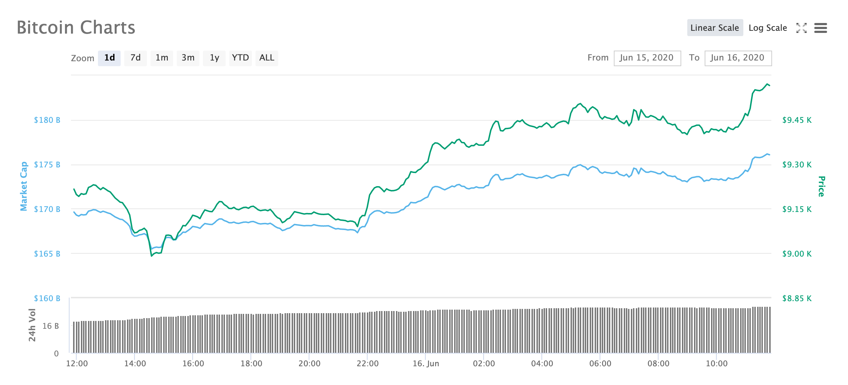
Sharp cryptocurrency market volatility
6.7%

Slide 6
Social media opinion is a good indicator of market price

Slide 7
Big Data Era
1 ZB = 1000⁷bytes = 10²¹bytes = 1000000000000000000000bytes

Slide 8
Real-Time Data Explosion

Slide 9
Outline
Background & Motivation
Objective
System Architecture
System Deployment Specification
Experiment Results

Slide 10
Objective
Develop a cryptocurrency analyzation system that can handle massive amount of data in real-time.
High Throughput, Low Latency

Slide 11
Outline
Background & Motivation
Objective
System Architecture
System Deployment Specification
Experiment Results

Slide 12
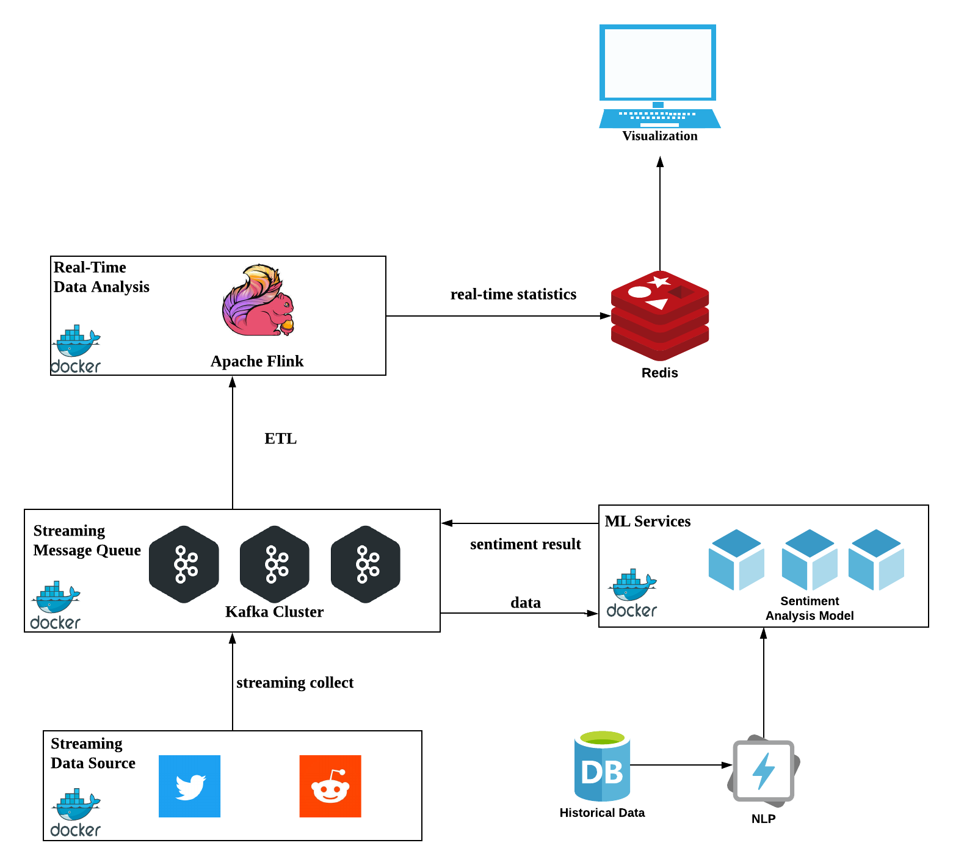
System Architecture

Slide 13
System Architecture

Slide 14
Outline
Background & Motivation
Objective
System Architecture
System Deployment Specification
Experiment Results

Slide 15
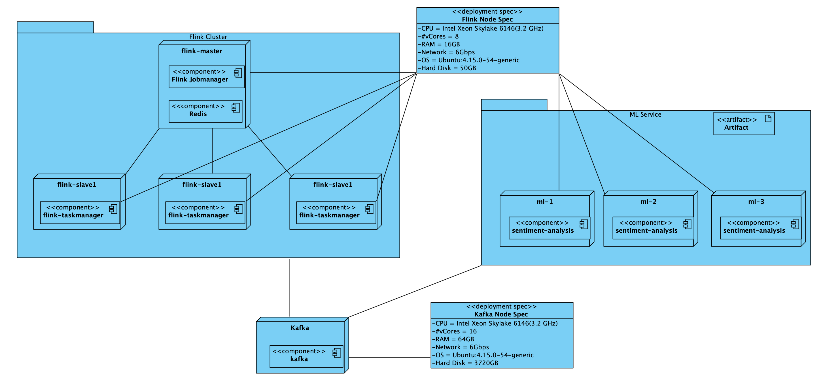
Deployment Diagram

Slide 16
Deployment Diagram
Use Docker
For easy deployment

Slide 17
Outline
Background & Motivation
Objective
System Architecture
System Deployment Specification
Experiment Results

Slide 18
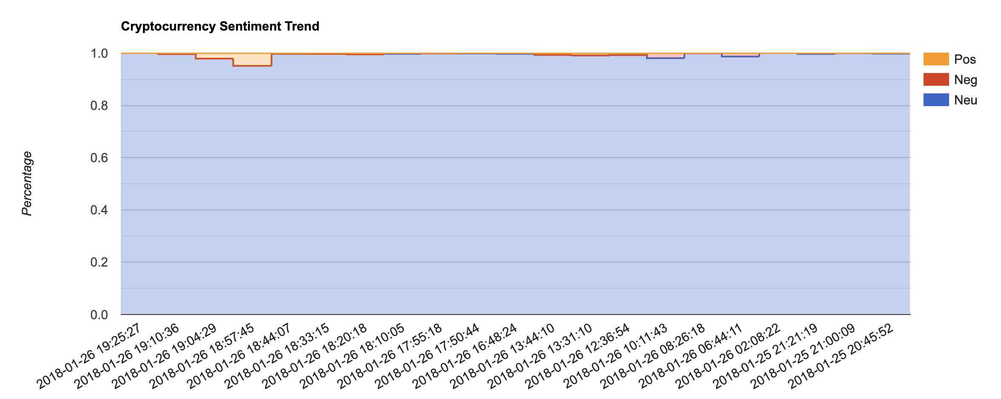
Indicator 1 -
Percentage of Opinion Mood
This zizag may imply a positive trend
We aggregate opinion mood (negative, neutral, positive) for every 100 tweets.

Slide 19

Indicator 2 -
30 Most Common Words
People are hyping iota in Jan,2018
30 Most Common Words

Slide 20
Performace
Experiment Results:
The system can process 6378 tweets per second. ML services becomes a bottleneck for the whole system.
We have two options to improve it:
Scale out ML service, add more machine for it.
Ship some container to the physical machine of flink cluster

Slide 21
Future Work
Our system still has much room for improvements.
First, We only used several features of each tweets. In future, we plan to extend the system to include more features of tweets. This will give our users a broader overview to current status of cryptocurrencies.
Second, the system running parameters (eg. window size) are hard coded, in future, we plan to make it configurable dynamically. We will optimize the system by taking into account user requirements.
Third, other indicators can be introduced into the system. Currently, we only got two descriptive indicators. More quantitative indicators can be measured and improve the predicting result by combining them together according to weight.

Slide 22
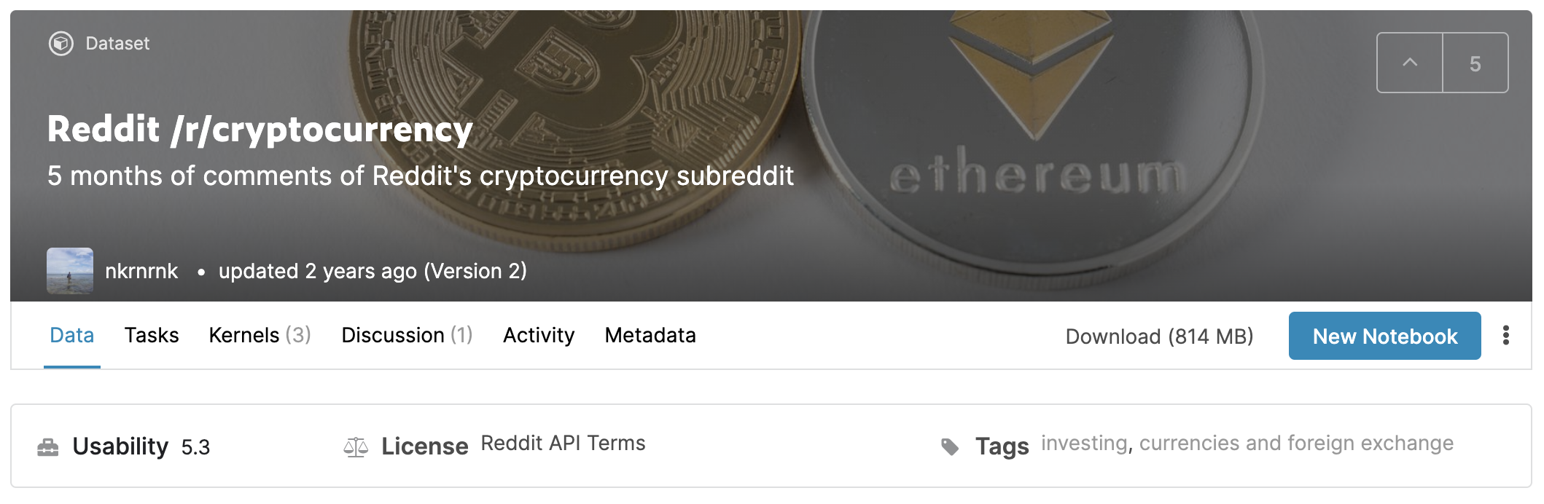
Problem Solving 1
There is a rate limit for free API users. We can only initiate no more than 450 requests in 15 minutes window (Twitter Streaming API). Unfortunately, the Reddit streaming API has the same problem. To address this issue, one solution is to collect data in advance, another solution is to pay for API access. Because our time and budget are limited, we decide to use archive data to simulate streaming data source.

Slide 23
Problem Solving 2
When executing the system, we found that only one sentiment analysis processor is consuming messages from Kafka. After some inspection, we realized that the problem comes from the partition number of Kafka cluster should be set as large as 16 not 1.

